Slide 1


X
deepFRAUD
March 2025
Fraud
Detection

Slide 2

WHY FRAUD DETECTION?
With our custom-built fraud detection model, you will:
Prevent revenue loss by identifying fraudulent consumption early
Increase efficiency by reducing time-consuming manual investigations
Ensure fair billing practices to maintain customer trust and regulatory compliance
X

Slide 3
X
OVERVIEW
Part 1
Part 2
Part 3
Getting the best out of the data
Finding the best model for prediction
Conclusion & Evaluation

Slide 4
X
Part 01
Getting the best out of the data

Slide 5
Merging Data
Client data
Client ID
Client Category – Classification of the customer
Region
Target (Fraud/Non-Fraud)
Invoice data
Tarif Type – pricing category
Consumption – in kWh (elec.) or m³ (gaz)
Months - timespan of the invoice
Reading Remark – annotations for counter readings
Counter Type – gaz or electricity
135,493
4,476,749
X

Slide 6
Merging Data
Data
Client ID
Client Category – Classification of the customer
Region
Target (Fraud/Non-Fraud)
Tarif Type – pricing category
Consumption – in kWh (elec.) or m³ (gaz)
Months - timespan of the invoice
Reading Remark – annotations for counter readings
Counter Type – gaz or electricity
53 Features
135,433
X

Slide 7
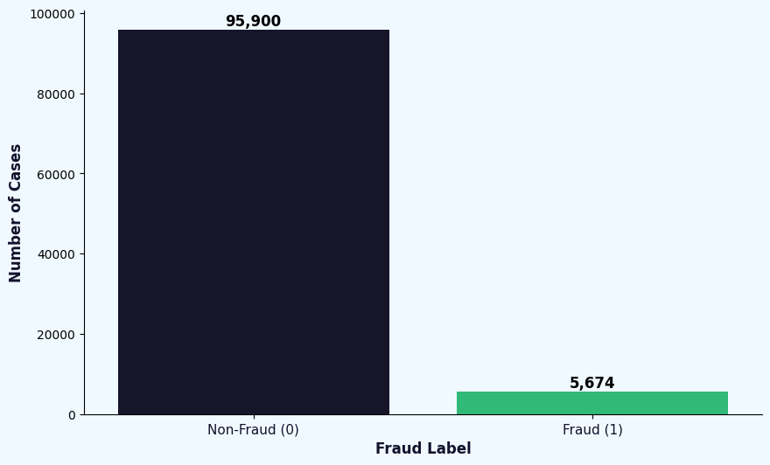
Imbalanced Data
X

Slide 8
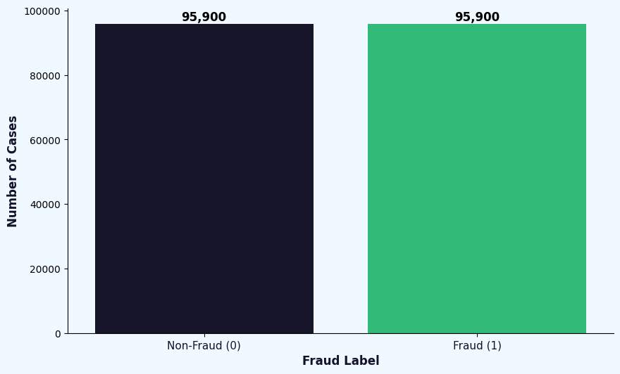
Oversampling
X

Slide 9
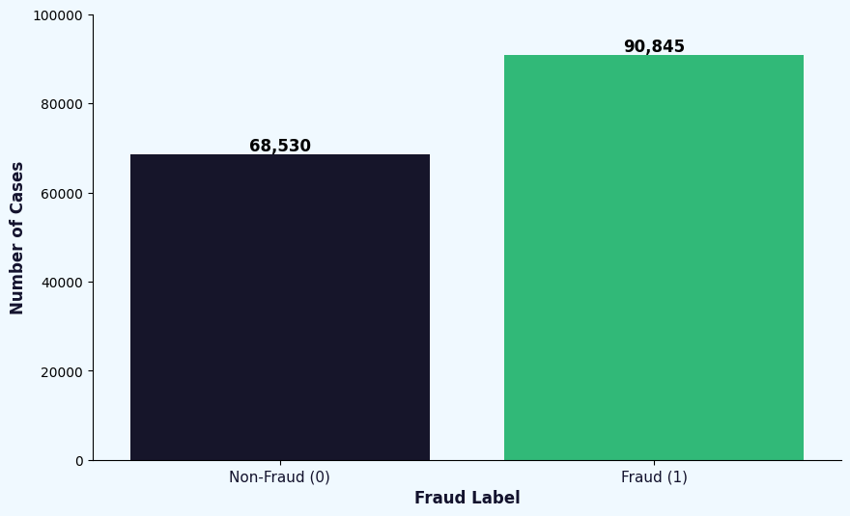
SMOTE*
*
Synthetic Minority Oversampling Technique
X

Slide 10
X
Part 02
Finding the best model for prediction

Slide 11
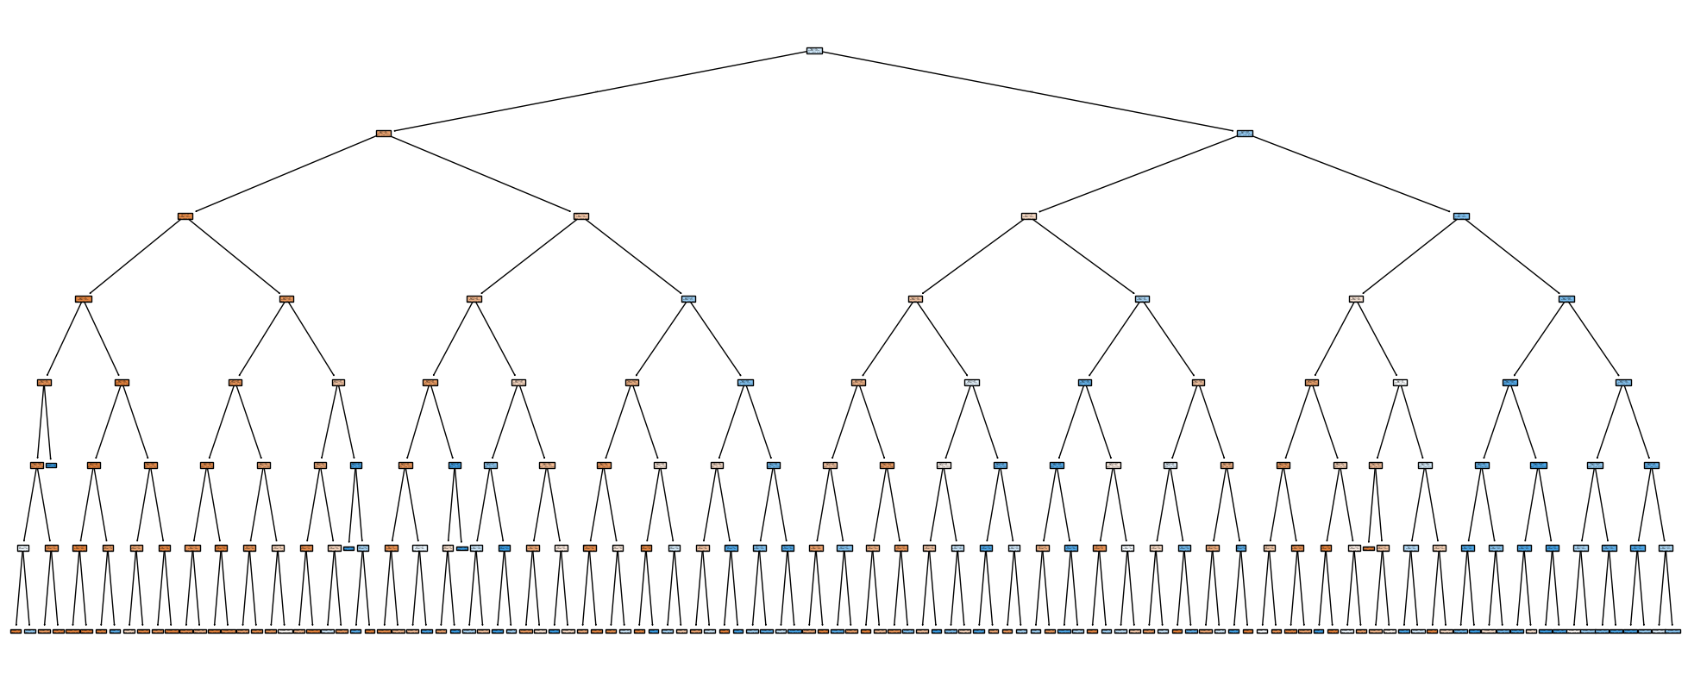
Decision Tree
A simple model with a single Decision Tree and a maximum depth of 7, oversampling applied
Baseline Model
X

Slide 12
Random Forest
A model with multiple decision trees that work together by averaging their outcomes
Approaches to get the best model
Stacking
A technique that combines multiple different models (base learners) and uses a meta-model to learn from their predictions
(DecisionTree, KNN, SGDClassifier)
Boosting
A method that trains models sequentially, where each model corrects the errors of the previous one, gradually improving performance
X

Slide 13
ROC AUC
Measures how well the model separates fraud from non-fraud
→ used for overall assessment
Recall
The percentage of actual fraud cases correctly identified
→ important as the goal is to identify as much fraud as possible
Main KPIs and their priority for evaluating the models
Accuracy
The proportion of all correct predictions out of total cases.
Precision
The percentage of predicted fraud cases that are actually fraud.
F1 Score
The balance between Precision and Recall.
X

Slide 14
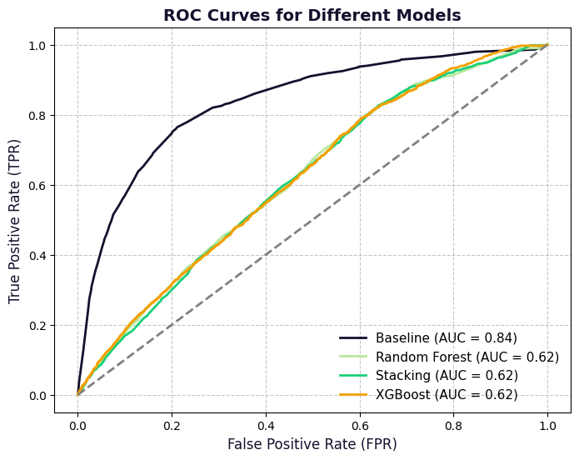
Model Comparison - ROC Curves
The Baseline model is by far outperforming the complex models
all complex model achieve the same ROC AUC values of 0.62 while the Baseline model achieves 0.84
X

Slide 15
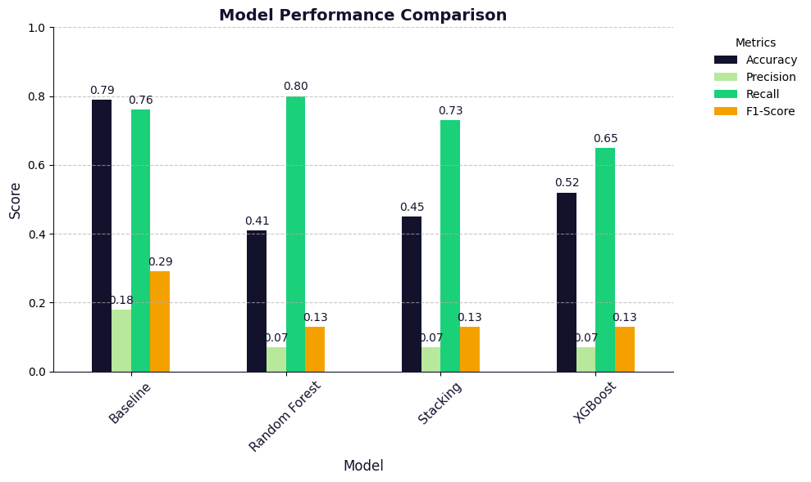
Model Comparison - Other KPIs
Also looking at the other KPIs Accuracy, Precision, Recall and the F1 Score, the Baseline Model achieves the overall best results
X

Slide 16

Random Forest
A model with multiple decision trees that work together by averaging their outcomes
Decision Tree
A simple model with a single Decision Tree and a maximum depth of 7, oversampling applied
Stacking
A technique that combines multiple different models (base learners) and uses a meta-model to learn from their predictions
Boosting
A method that trains models sequentially, where each model corrects the errors of the previous one, gradually improving performance
X

Slide 17
X
Part 03
Conclusion & Evaluation

Slide 18

CONCLUSION
A Simple solution can be the best
Still need to check and compare with different models
Importance of EDA and Feature Engineering
Fraud detection is difficult to detect and compound correlations hard to find
Working as a team is essential
X

Slide 19

LOOK FURTHER
Optimize the base model again
More Data Engineering
Read the decision tree as good as possible
X

